Slide 1

Module -2 – CMOS inverter
By
Dr.Rohit Lorenzo
Assistant Professor Sr. Grade -1
School of Electronics Engineering (SENSE)

Slide 2
Modeling of MOS Transistor using SPICE
SPICE (Simulation Program with Integrated Circuit Emphasis) is a general-purpose circuit simulator which is used very widely both in the microelectronics industry and in educational institutions as an essential computer-aided design (CAD) tool for circuit design.
In the fast-advancing field of VLSI design, a sound knowledge of physical models used to describe the behavior of transistors and knowledge of various device parameters are essential for performing detailed circuit simulations and for optimizing design.
SPICE has three built-in MOSFET models –
LEVEL 1 (MOS1) is described by a square-law. current-voltage characteristic.
LEVEL 2 (MOS2) is a detailed analytical MOSFET model.
LEVEL 3 (MOS3) is a semi-empirical model.
Both MOS2 and MOS3 include second-order effects such as the short-channel threshold voltage, subthreshold conduction, scattering-limited velocity saturation, and charge-controlled capacitances.

Slide 3
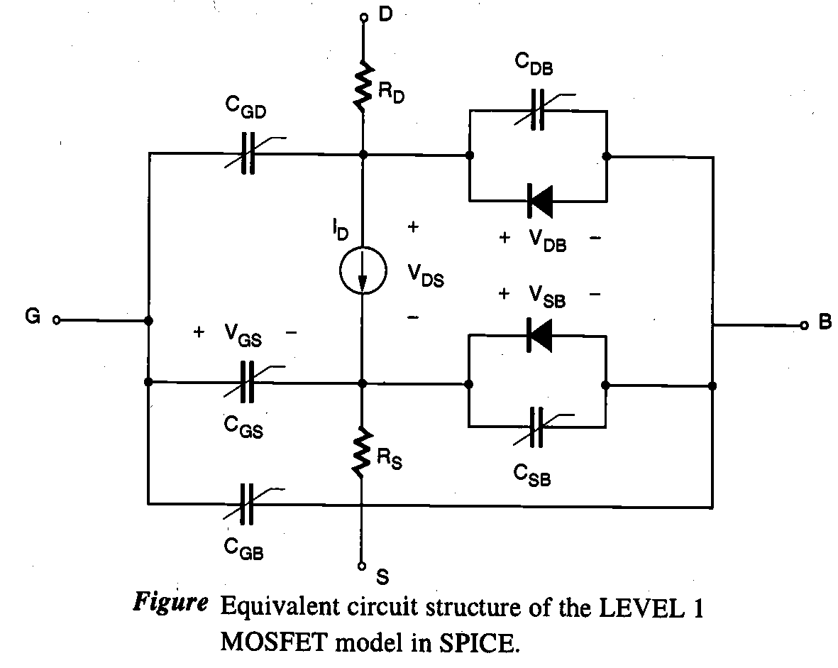
Basic Concepts
The source-substrate and the drain-substrate junctions, which are reverse-biased under normal operating conditions, are represented by ideal diodes in this equivalent circuit.
The parasitic source and drain resistances
are represented by the resistors R_{D} and R_{s},
respectively, connected between the drain
current source and the respective terminals.

Slide 4
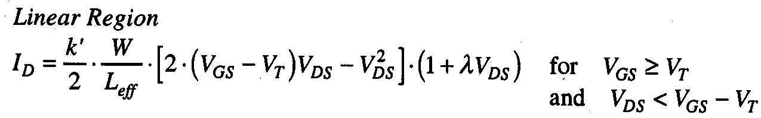
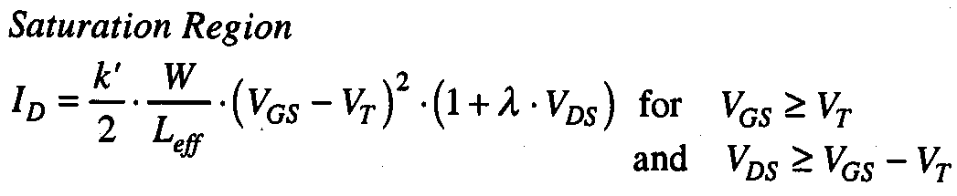
The LEVEL 1 Model Equations
The LEVEL 1 model is the simplest current-voltage description of the MOSFET, which is basically the GCA-based quadratic model.
The equations used for the LEVEL 1 n-channel MOSFET model in SPICE are as follows.

Slide 5
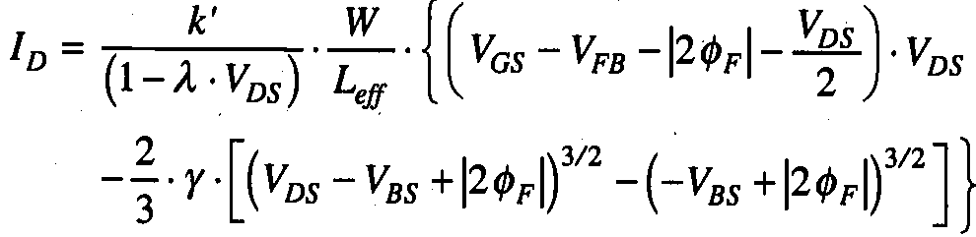
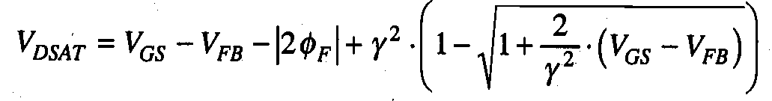
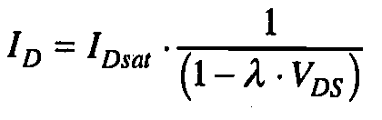
The LEVEL 2 Model Equations
To obtain a more accurate model for the drain current, it is necessary to eliminate some of the simplifying assumptions made in the original GCA analysis.
Specifically, the bulk depletion charge must be calculated by taking into account its dependence on the channel voltage. current-voltage characteristics in model 2 can be obtained as –
The saturation voltage V_{DSAT} can be calculated as
Saturation mode current

Slide 6
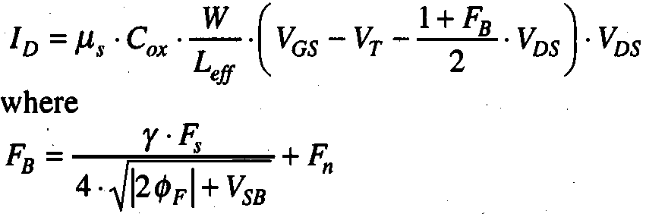
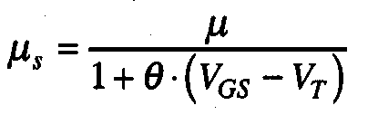
The LEVEL 3 Model Equations
The majority of the LEVEL 3 model equations are empirical. The aims of using empirical equations instead of analytical models are both to improve the accuracy of the model and to limit the complexity of the calculations.
The drain current in the linear region
is given by the following equation:
the empirical parameter F_{B} expresses the dependence of the bulk depletion charge on the three-dimensional geometry of the MOSFET. Here, the parameters V_{T}, F_{s}, and μ_{s} are influenced by the short-channel effects, while the parameter F_{n} is influenced by the narrow-channel effects.

Slide 7
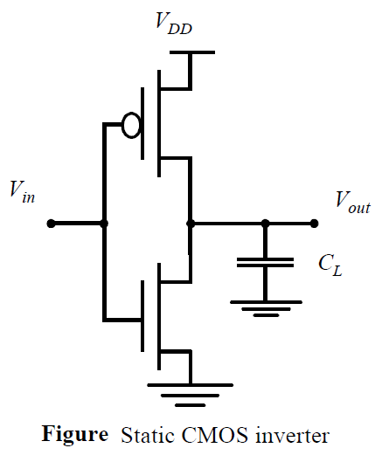
CMOS Inverter
The inverter is truly the nucleus of all digital designs. Once its operation and properties are clearly understood, designing more intricate structures such as NAND gates, adders, multipliers, and microprocessors is greatly simplified.
The analysis of inverters can be extended to explain the behavior of more complex gates such as NAND, NOR, or XOR, which in turn form the building blocks for modules such as multipliers and processors.
Static CMOS Inverter
Inverter operation is readily understood with the aid of the simple switch
model of the MOS transistor.
The transistor is nothing more than a switch with an infinite OFF resistance
( for V_{GS}<V_{T}) and a finite on-resistance ( for V_{GS}>V_{T}) .

Slide 8
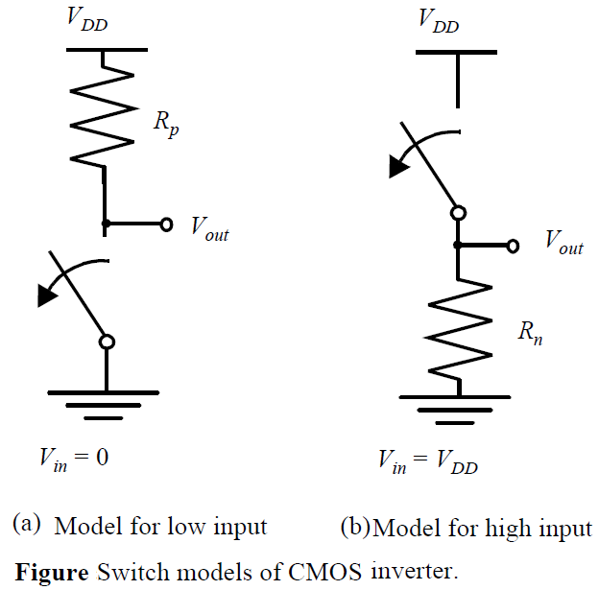
Continue….
When V_{in} is low (0 V), NMOS and PMOS transistors are OFF and ON, respectively. The equivalent circuit of Figure (a) shows that a path exists between V_{DD} and V_{out}, yielding a high output voltage.
When V_{in} is high and equal to V_{DD}, the NMOS transistor is ON, while the PMOS is OFF. This yields the equivalent circuit of Figure (b). A direct path exists between V_{out} and the ground node,

Slide 9
Continue….
Important properties of static CMOS inverter
High noise margins -The high and low output levels equal V_{DD} and GND, respectively; in other words, the voltage swing is equal to the supply voltage. This results in high noise margins.
Ratioless Logic -The logic levels are not dependent upon the relative device sizes, so that the transistors can be minimum size. Gates with this property are called ratioless.
High Input Impedance - The input impedance of the CMOS inverter is extremely high, as the gate of an MOS transistor is a virtually perfect insulator and draws no dc input current. Since the input node of the inverter only connects to transistor gates. A single inverter can theoretically drive an infinite number of gates in static case. however, increasing the fan-out also increases the propagation delay in transient case.
Low output Impedance -In steady state, there always exists a path with finite resistance between the output and either V_{DD} or GND. A well-designed CMOS inverter, therefore, has a low output impedance, which makes it less sensitive to noise and disturbances.
static power -No direct path exists between the supply and ground rails under steady-state operating conditions (this is, when the input and outputs remain constant). The absence of current flow (ignoring leakage currents) means that the gate does not consume much static power.

Slide 10
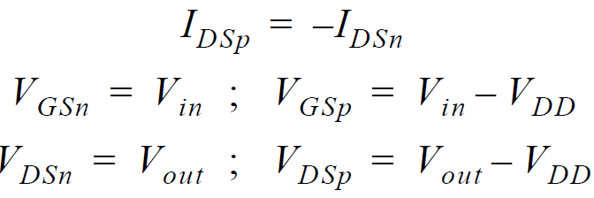
CMOS Inverter voltage-transfer characteristic
The nature and the form of the voltage-transfer characteristic (VTC) can be graphically deduced by superimposing the current characteristics of the NMOS and the PMOS devices.
It requires that the I-V curves of the NMOS and PMOS devices are transformed onto a common coordinate set. The PMOS I-V relations can be translated into this variable space by the following relations.
……..(1)

Slide 11
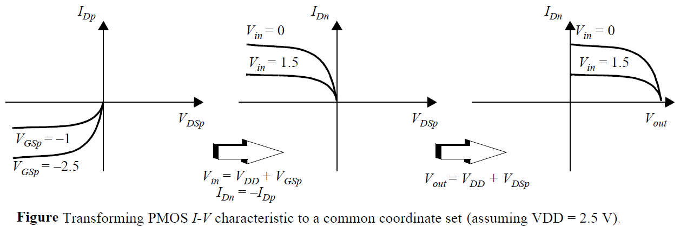
Continue…….
The load-line curves of the PMOS device are obtained by a mirroring around the x-axis and a horizontal shift over V_{DD}.

Slide 12
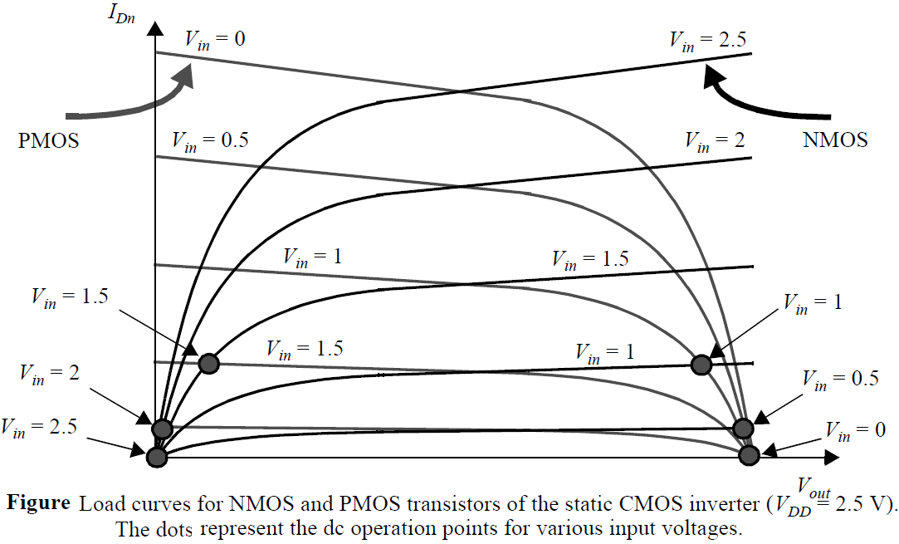
Continued….
The resulting load lines are shown in figure. For a dc operating points to be valid, the currents through the NMOS and PMOS devices must be equal.
Graphically, this means that the dc points must be located at the intersection of corresponding load lines.
A number of those points (for V_{in} = 0, 0.5, 1, 1.5, 2, and 2.5 V) are marked on the graph.
As can be observed, all operating points are
located either at the high or low output levels.

Slide 13
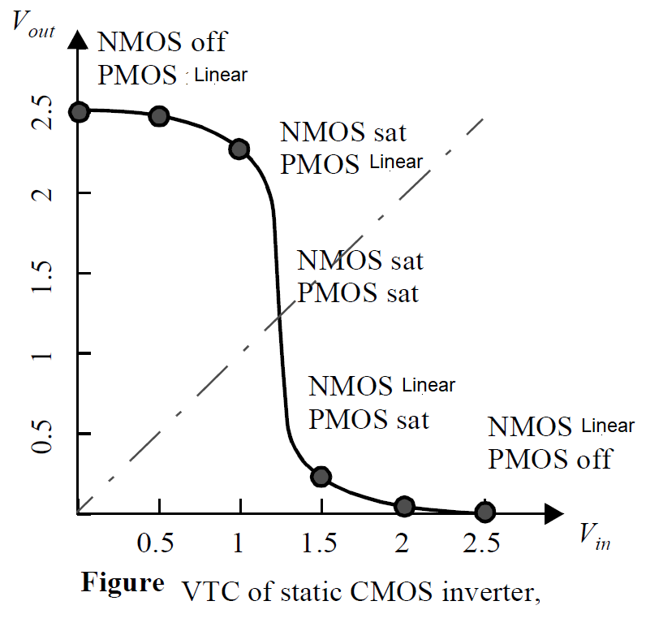
Continue….
In that operation region, a small change in the input voltage results in a large output variation. All these observations translate into the VTC doped silicon substrate.
Before going into the analytical details of the operation of the CMOS inverter, a qualitative analysis of the transient behavior of the gate.
The gate response time is simply determined by the
time it takes to charge the capacitor C_{L} through
The resistor R_{p.} we learned that the propagation delay of
such a network is proportional to the its time constant
R_{p}C_{L.}
Hence, a fast gate is built either by keeping the output
capacitance small or by decreasing the on-resistance
of the transistor. The latter is achieved by
increasing the W/L ratio of the device.

Slide 14
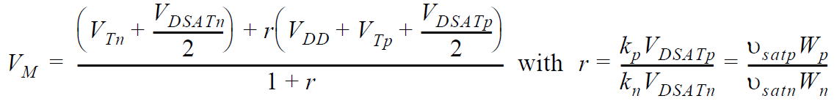
Switching Threshold
The switching threshold, V_{M}, is defined as the point where V_{in} = V_{out}. Its value can be obtained graphically from the intersection of the VTC with the line given by V_{in} = V_{out} . In this region, both PMOS and NMOS are always saturated.
We solve the case where the supply voltage is high so that the devices can be assumed to be velocity-saturated (V_{DSAT} < V_{M} - V_{T}). We furthermore ignore the channel length modulation effects.
_{…….(2)}
Solving for V_{M} yields
_{……(3)}

Slide 15
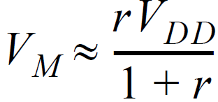
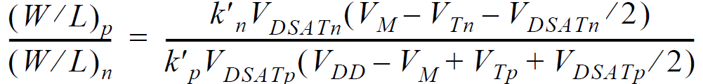
continue…….
For large values of V_{DD} Eq. (3) can be simplified …..(4)
we can derive the required ratio of PMOS versus NMOS transistor sizes such that the switching threshold is set to a desired value V_{M.} When using this expression, please make sure that the assumption that both devices are velocity-saturated still holds for the chosen operation point.
_{…….(5)}

Slide 16
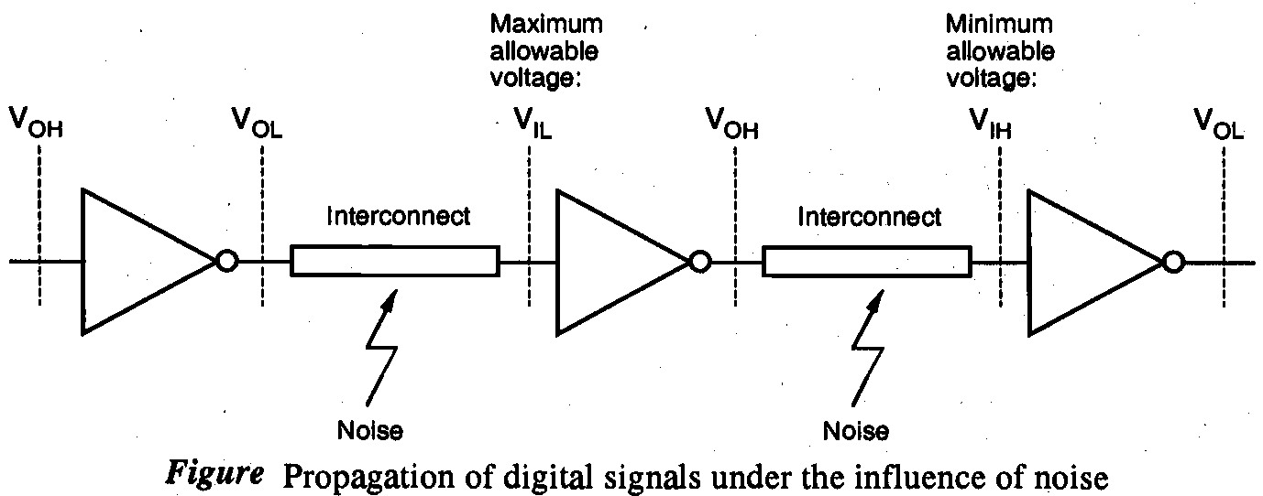
CMOS Inverter - Noise Margin
Definition - The amount of noise voltage which the inverter can reject without effecting the output.
If higher is the value of noise margin better is the capability of inverter.
In given figure this output signal of first inverter is being transmitted to the second inverter input via an interconnect, which is prone to signal noise.
Consequently , If the input voltage of the second inverter is smaller than V_{OL}' this signal will be interpreted correctly as a logic "0" input by the second inverter. On the other hand, if the input voltage becomes larger than V_{IL} as a result of noise, then it may not be interpreted correctly by the inverter. Thus, we conclude that V_{IL} is the maximum allowable voltage at the input of the second inverter, which is low enough to ensure a logic "1" output.
Same way it is applicable
For second and third
Inverter.

Slide 17


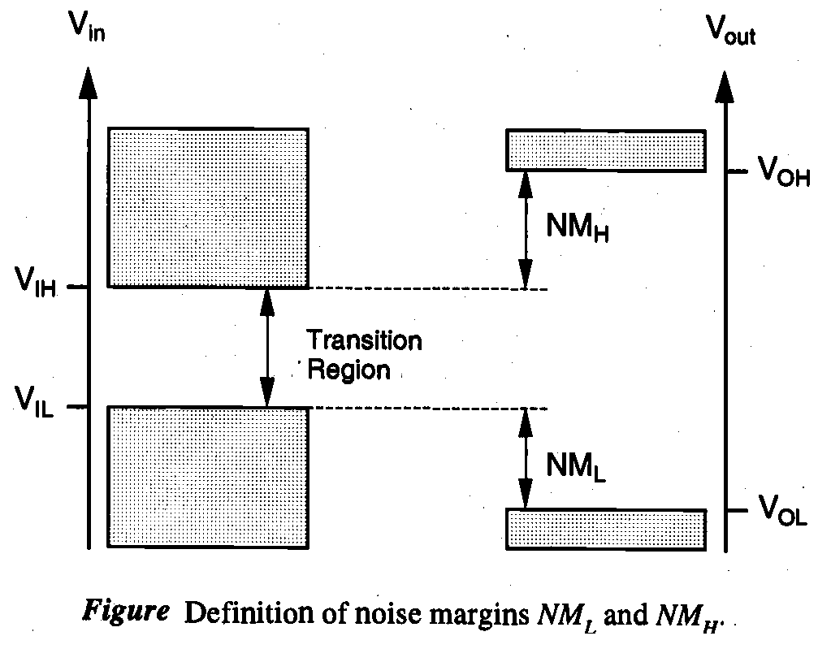
Continued…
So from previous observation noise tolérances for digital circuits, called noise margins and denoted by NM.
Two noise margins will be defined: the noise margin for low signal levels (NM_{L}) and the noise margin for high signal levels (NM_{H}) .
…..(6)
The shaded areas indicate the valid regions of the input and
output voltages, and the noise margins are shown as the
amount of variation in the signal levels that can be allowed
while the signal is transmitted from the output of one gate to
the input of the next gate.
Note that there is a voltage range between V_{IL} and V_{IH}
corresponding to input voltage values. The region between
V_{IL} and V_{IH} is called uncertain region or alternatively the
transition region.

Slide 18



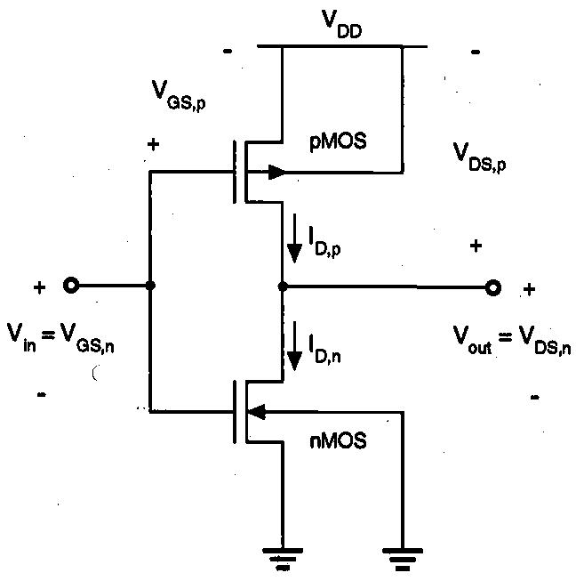




Calculation of Voltages in CMOS Inverter
CMOS Inverter circuit voltage configuration is shown in figure. According to circuit diagram voltages can be written as –
……. (7)
……..(8)
When the nMOS transistor is cut-OFF. The PMOS
transistor is on, operating in the linear region. Since the drain
currents of both transistors are approximately equal to zero.
…….(9)
……(10)

Slide 19





Continued….
when the input voltage exceeds the PMOS transistor is turned off and NMOS transistor is operating in the linear region. Consequently, the output voltage of the circuit is
……(11)
The NMOS transistor operates in saturation if if the following condition is satisfied
……(12)
The PMOS transistor operates in saturation if
……(13)

Slide 20
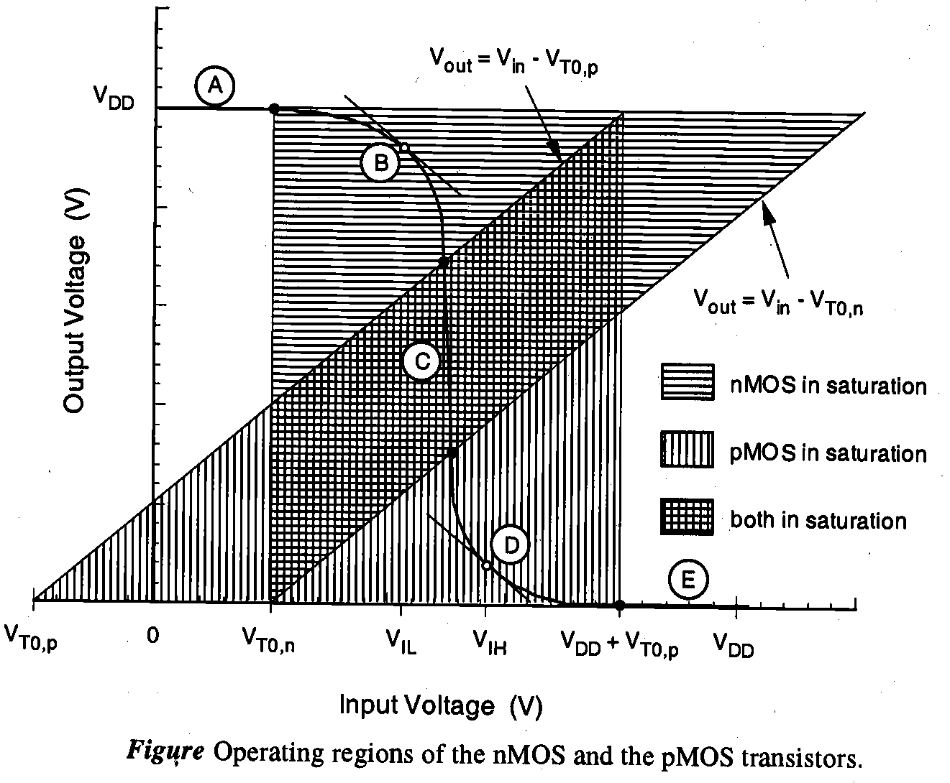
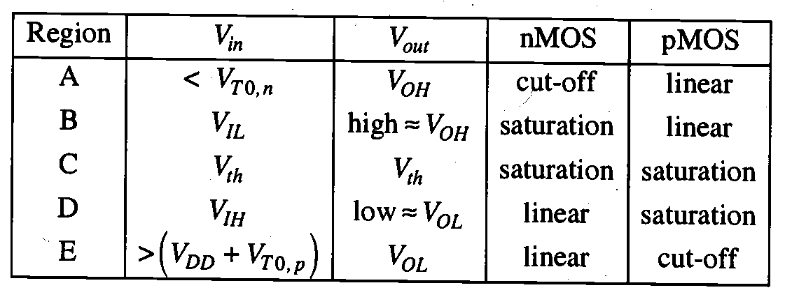
Continue…..
Here, we identify five distinct regions, labeled A through E, each corresponding to a different set of operating conditions

Slide 21


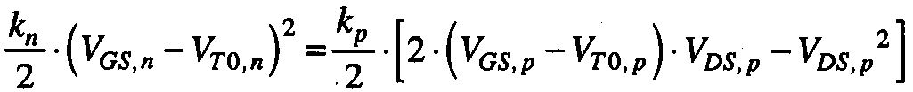
Continue….
We already know that the drain current I_{D,n} of the NMOS transistor is a function of the voltages V_{GS,n} and V_{DS,n}. The NMOS drain current is also a function of the inverter input and output voltages V_{in}. and V_{out.}
Similarly for PMOS
Calculation of V_{IL}
By definition, the slope of the VTC is equal to (-1), dV_{out}/dV_{in} = -1. when the input voltage is V_{in} = V_{IL} .
Note that in this case, the NMOS transistor operates in saturation while the PMOS transistor operates in the linear region. From I_{D,n} = I_{D,p} . we obtain the following current equation:
…(14)
Using equation (7) and (8) , this expression can be rewritten as –
…….(15)

Slide 22
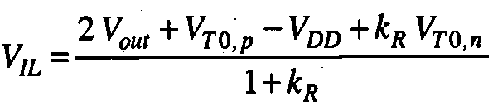
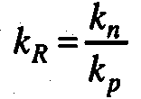
Continue…..
Differentiate equation (15) with respect to V_{in} .
…(16)
Substitute V_{in} = V_{IL} and dV_{out}/dV_{in} = -1 in equation (16)
…..(17)
Voltage V_{IL} can now found as a function V_{out}
…..(18)
_{Where}

Slide 23
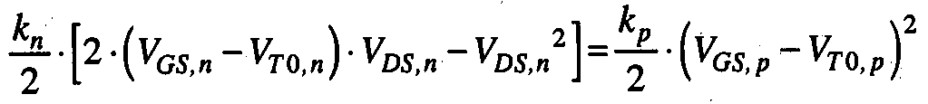
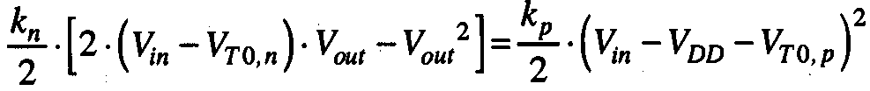
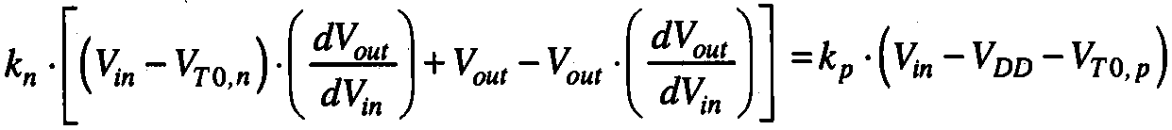
Calculation of V_{IH}
When the input voltage is equal to V_{IH}, the NMOS transistor operates in the linear region, and the PMOS transistor operates in saturation. Apply KCL to the output node I_{D,n} = I_{D,p} .
……(19)
Using equation (7) and (8) , this expression can be rewritten as
…(20)
Now, differentiate both sides of (20) with respect to V_{in}
….(21)
Substitute V_{in} = V_{IH} and dV_{out}/dV_{in} = -1 in equation (20)
….(22)

Slide 24
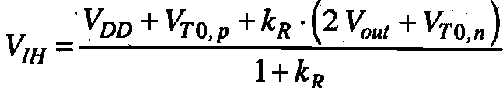
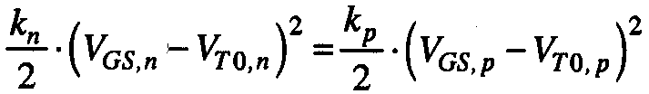
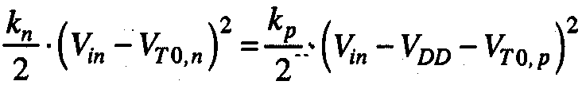
Continued….
The critical voltage V_{IH} can now be found as a function of V_{out}, as follows –
……(23)
Calculation of V_{Ith}
The inverter threshold voltage is defined as V_{th} = V_{in} =V_{out .} For V_{in} = V_{out}, both transistors are expected to be in saturation mode. Hence we can write KCL equation.
_{…….(23)}
Using equation (7) and (8) , this expression can be rewritten as
…… (24)

Slide 25
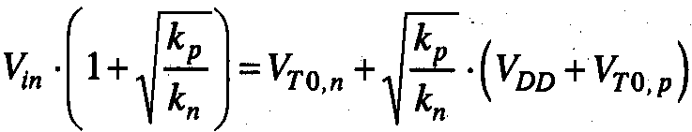
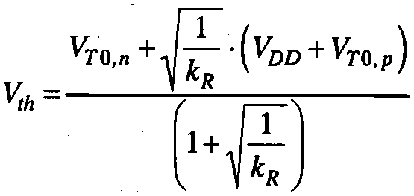
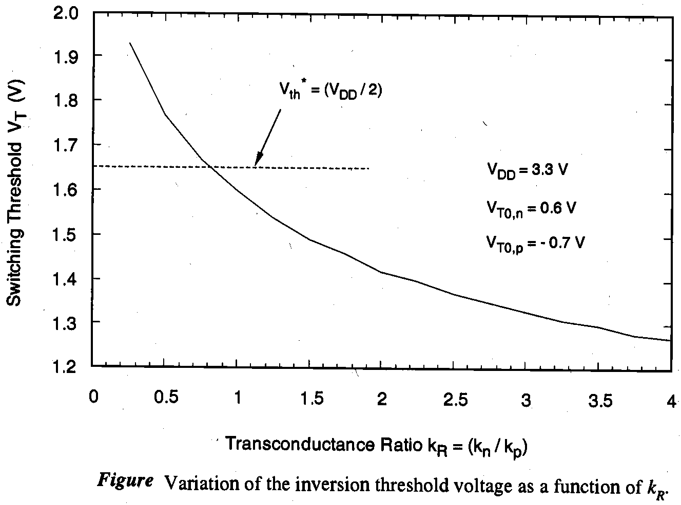
Continued….
The correct solution for V_{in} for this equation is
……(25)
Finally, the inverter threshold (switching threshold) voltage V_{th} is found as
…….(26)

Slide 26
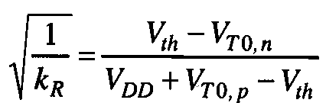
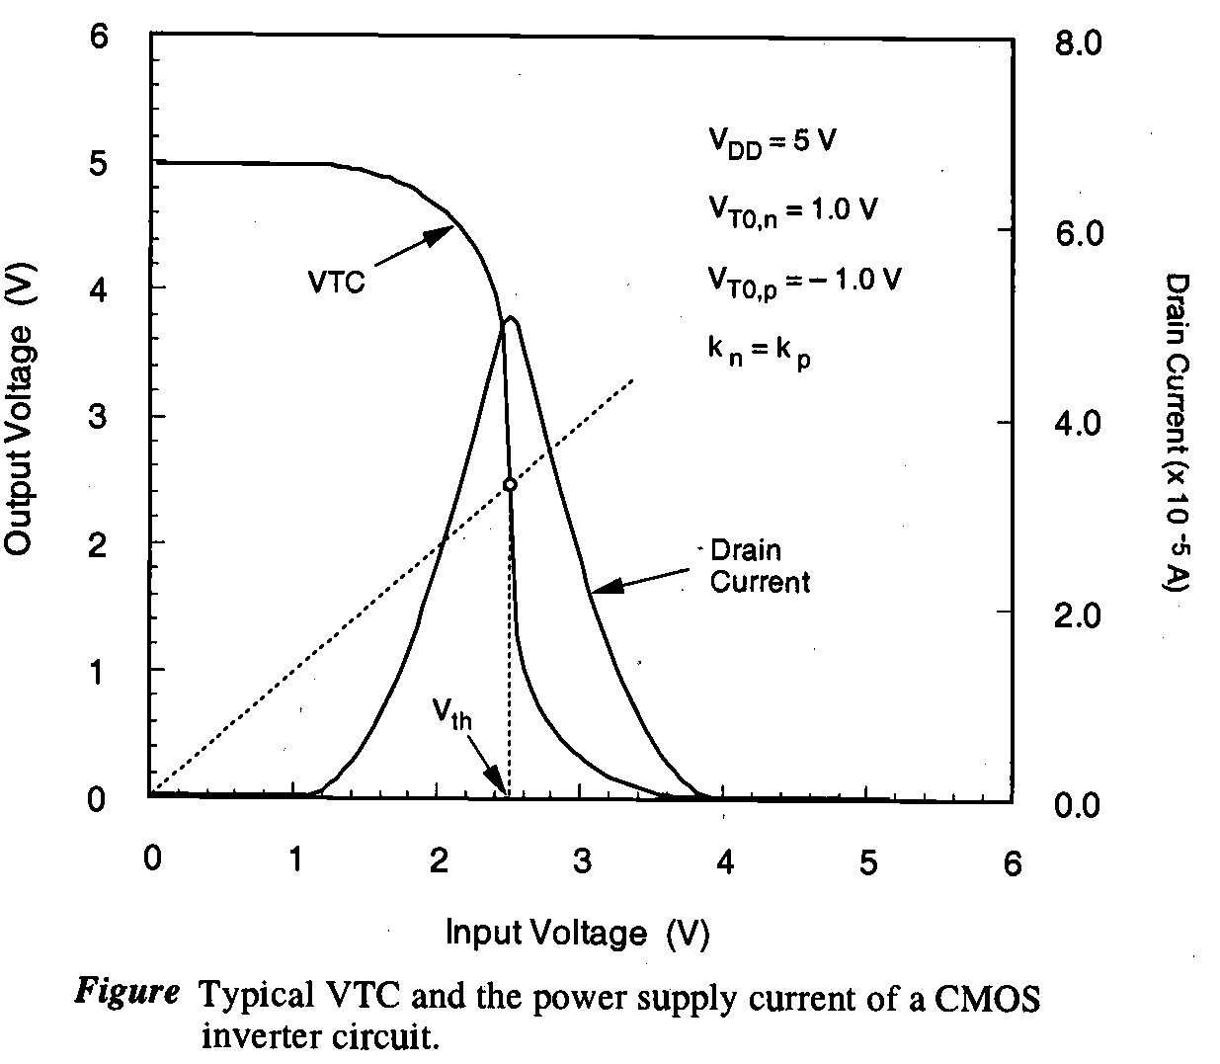
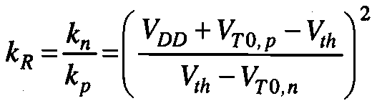

Design of CMOS Inverters
The inverter threshold voltage V_{th} was identified as one of the most important parameters that characterize the steady-state input-output behavior of the CMOS inverter circuit.
The problem of designing a CMOS inverter can be reduced to setting the inverter threshold to a desired voltage value. The corresponding ratio k_{R} can be found as follows. reorganizing (26) yields.
……(27)
Solve the K_{R} that is required to achieve the given V_{th}.
……(28)
Recall that the switching threshold voltage of an ideal inverter is
defined as
……(29)

Slide 27
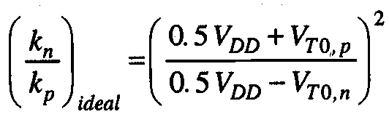
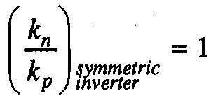
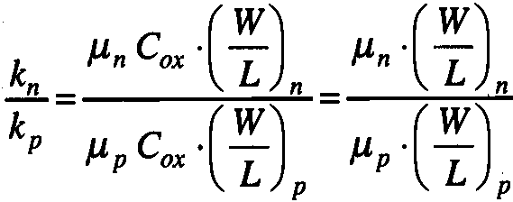
Continue….
Substitute the value from (29) in (28).
….(30)
We can achieve completely symmetric input-output characteristics by setting the threshold voltages as
V_{T0} = VT_{0,n} = |VT_{0,p} | . This reduces equation (30)
… (31)
Note that the ratio k_{R} is defined as
……(32)

Slide 28
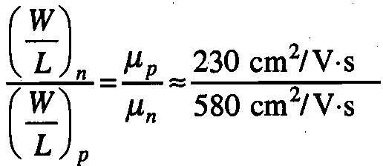
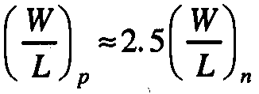
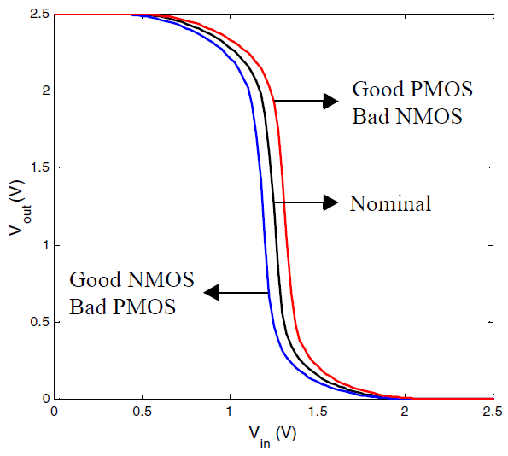
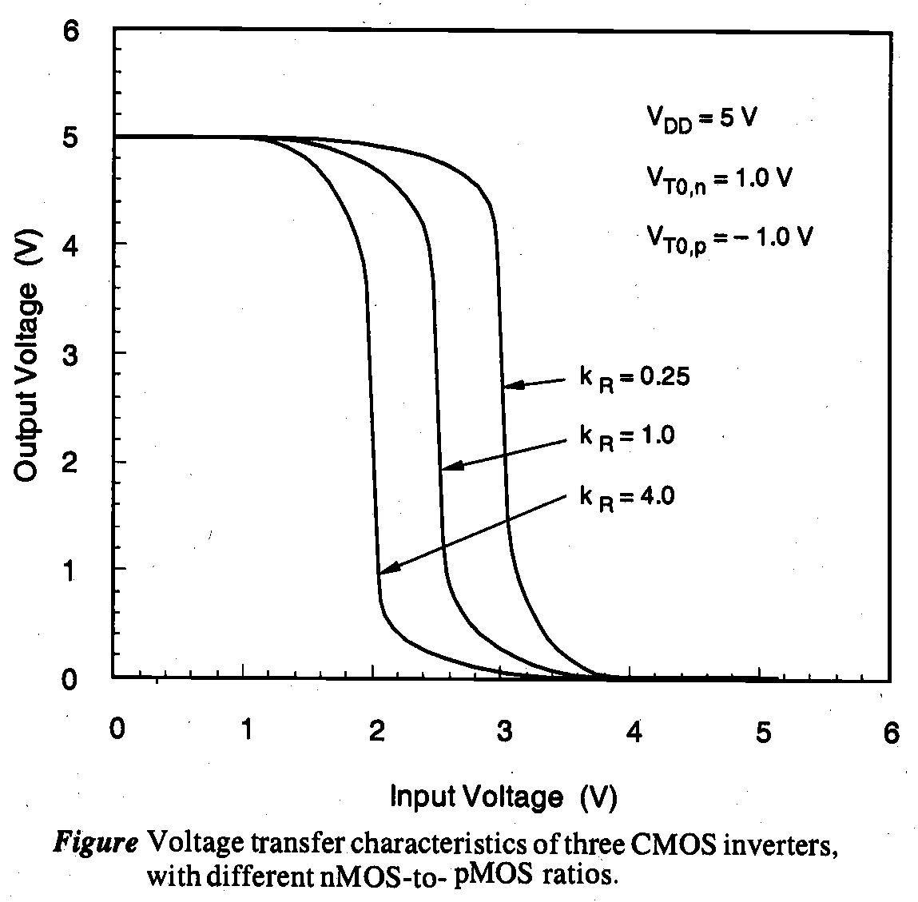
Continued……
Assume the same t_{ox} and C_{ox .} The unity-ratio condition (32) for the ideal symmetric inverter.
…. (32) …. (33)
The VTCs of three CMOS inverter circuits with different k_{R} ratios are shown in Fig. It can be seen clearly that the inverter threshold voltage V_{th} shifts to lower values with increasing k_{R} ratio.

Slide 29
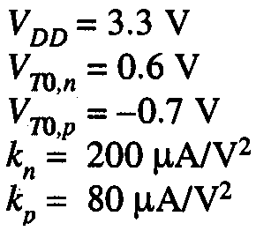

Problem 1
Consider a CMOS inverter circuit with the following parameters:
Calculate the noise margins of the circuit. Notice that the CMOS inverter being considered here has
k_{R} = 2.5 and . hence, it is not a symmetric inverter.

Slide 30
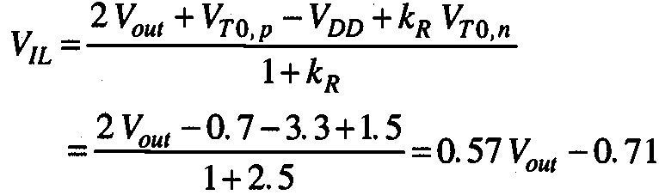



Solution
From equation (18)
Now substitute this in equation (17)
Now we can calculate the value in V_{IL}

Slide 31
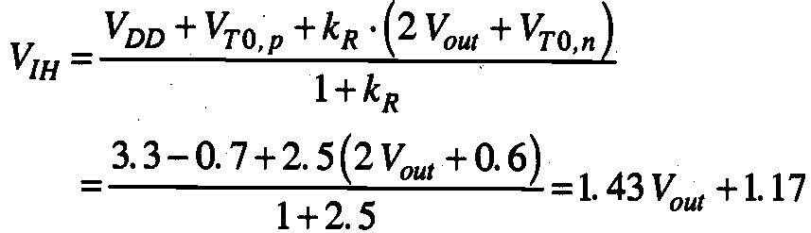
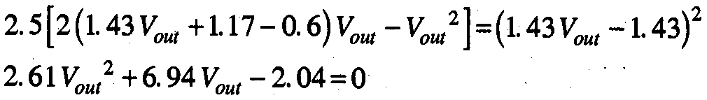


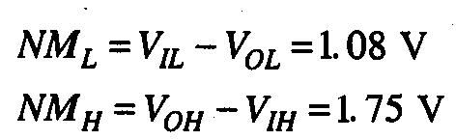
Continue…..
To calculate V_{IH} in terms of the output voltage, use
Use equation (20)
we can calculate the critical voltage V_{IH}
we can find the noise margin

Slide 32
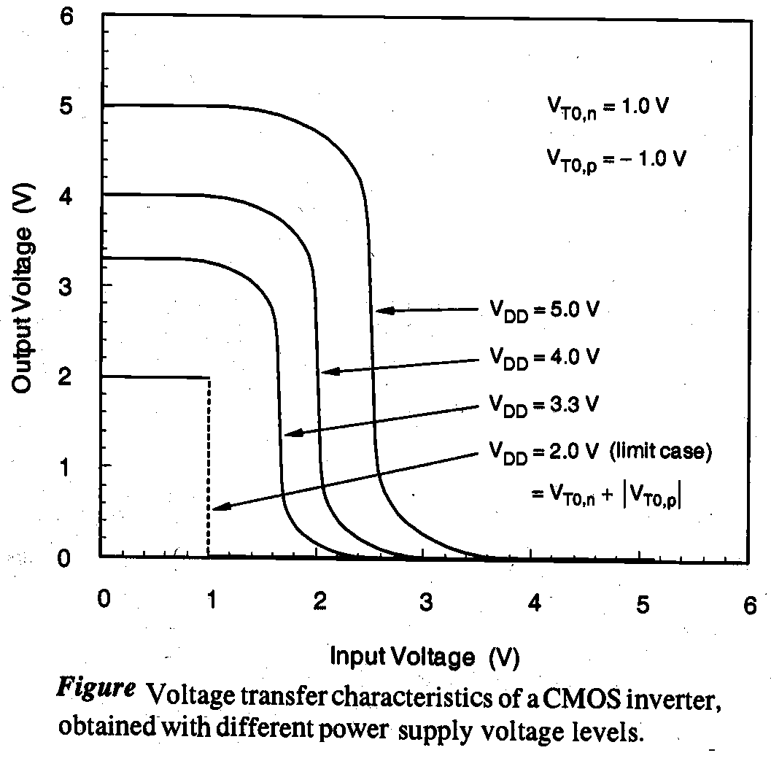
Supply Voltage scaling in CMOS
In the following, we will briefly examine the effects of supply
voltage scaling, i.e., reduction of V_{DD}, upon the static voltage
transfer characteristics of CMOS inverters. overall power
dissipation of any digital circuit is a strong function of the
supply voltage V_{DD}.

Slide 33

MOS Inverters : Dynamic Characteristics
We will investigate the dynamic (time-domain) behavior of the inverter circuits. The switching characteristics of digital integrated circuits and, in particular, of inverter circuits, essentially determine the overall operating speed of digital systems.
Introduction
The capacitances C_{gd} and C_{gs} are primarily due to gate overlap with diffusion, while C_{db} and C_{sb} are voltage-dependent junction capacitances. we also consider the lumped interconnect capacitance C_{int}, which represents the parasitic capacitance contribution of the metal or polysilicon.
we first combine the capacitances into an equivalent
lumped linear capacitance, connected between the
output node of the inverter and the ground.
This combined capacitance at the output node
will be called the load capacitance C_{load} .
…(1)

Slide 34

Continue….
In particular, C_{sb,n} and C_{sb,p} have no effect on the transient behavior. The capacitances C_{gs,n} and C_{gs,p} are also not included in (1) because they are connected to the input node. The capacitance terms C_{db,n} and C_{db,p} in (1) are the equivalent junction capacitances calculated for a particular output voltage transition.
The first-stage CMOS inverter is shown with the single
lumped output load capacitance C_{load .} Now, the problem
of analyzing the switching behavior can be handled more
easily.
In fact, the question of inverter transient response is
reduced to finding the charge-up and charge-down times
of a single capacitance which is charged
and discharged through one transistor.

Slide 35




Delay-Time Definitions
The propagation delay times and determine the input-to-output signal delay during the high-to-low and low-to-high transitions of the output, respectively.
By definition, is the time delay between the V_{50%} -transition of the rising input voltage and the V_{50%} -transition of the falling output voltage.
Similarly , is defined as the time delay between the V_{50%} -transition of the falling input voltage
and the V_{50%-} transition of the rising output voltage.
To simplify the analysis becomes the time required for
the output voltage to fall from V_{OH} to the V_{50%} level.
becomes the time required for the output voltage to
rise from V_{OL} to the V_{50%} level. The voltage point V_{50%}
is defined as follows
….(2)

Slide 36








Continue….
Thus, the propagation delay times …..(3)
The average propagation delay of the inverter characterizes the average time required for the input signal to propagate through the inverter.
…..(4)
The rise time is defined here as the time required
for the output voltage to rise from the V_{10%} level to V_{90%}
level.
The fall time is defined here as the time
required for the output voltage to drop from
the V_{90%} level to V_{10%} level.
…(5)

Slide 37
Performance of CMOS Inverter
The qualitative analysis presented earlier concluded that the propagation delay of the CMOS inverter is determined by the time it takes to charge and discharge the load capacitor C_{L} through the PMOS and NMOS transistors.
This observation suggests that getting C_{L} as small as possible is crucial to the realization of high-performance CMOS circuits.
It is hence worthwhile to first study the major components of the load capacitance before embarking onto an in-depth analysis of the propagation delay.
Computing the Capacitances
Manual analysis of MOS circuits where each capacitor is considered individually is virtually impossible.
To make the analysis tractable, we assume that all capacitances are lumped together into one single capacitor C_{L}, located between V_{out} and GND.
It includes all the capacitances influencing the transient response of node V_{out}.

Slide 38


Continue……
Gate-Drain Capacitance C_{gd12}
M1 and M2 are either in cut-off or in the saturation mode during the first half (up to 50% point) of the output transient. Under these circumstances, the only contributions to C_{gd12} are the overlap capacitances.
During a low-high or high-low transition, the terminals of the gate drain capacitor are moving in opposite directions. The voltage change over the floating capacitor is hence twice the actual output voltage swing.
We use the following equation for the gate-drain capacitors. – C_{gd} = 2C_{GD0}W

Slide 39


Diffusion Capacitances C_{db1} and C_{db2}
The capacitance between drain and bulk is due to the reverse-biased pn-junction. Such a capacitor is, unfortunately, quite nonlinear and depends heavily on the applied voltage.
A multiplication factor K_{eq} is introduced to relate the linearized capacitor to the value of the junction capacitance under zero-bias conditions
……(7)
Wiring Capacitance C_{w}
The capacitance due to the wiring depends upon the length and width of the connecting wires, and is a function of the distance of the fanout from the driving gate and the number of fanout gates.
Gate Capacitance of Fanout C_{g3} and C_{g4}
We assume that the fanout capacitance equals the total gate capacitance of the loading gates M3 and M4.
… ……(8)

Slide 40



Propagation Delay: First-Order Analysis
One way to compute the propagation delay of the inverter is to integrate the capacitor (dis)charge current. with i is the (dis)charging current, V the voltage over the capacitor, and v1 and v2 the
Initial and final voltage. ….(9)
An exact computation of this equation is intractable, as both C_{L}(v) and i(v) are nonlinear functions of V.
An expression for the average on-resistance of the MOS transistor.
This scenario is plotted in for the case of an NMOS discharging a capacitor from V_{DD} to V_{DD}/2.

Slide 41



Continue……
we can derive the value of the equivalent resistance, which averages the resistance of the device over the interval
…..(10)
Deriving the propagation delay of the resulting circuit is now straightforward, and is nothing more than the analysis of a first-order linear RC-network. the propagation delay of such a network for a voltage step at the input is proportional to the time-constant of the network.
…..(11)
Similarly, we can obtain the propagation delay for the low-to-high transition
…..(12)
R_{eqp} and R_{eqn} the equivalent on-resistance of the PMOS and NMOS transistor. The overall propagation delay of the inverter is defined as the average of the two values.
…..(13)

Slide 42


Continue……
Combining Eq. (10) and Eq. (11), and assuming for the time being that the channel- length modulation factor l is ignorable, yields the following expression for t_{pHL} .
……(14)
In the majority of designs, the supply voltage is chosen high enough so that V_{DD}>>V_{Tn}+V_{DSATn}/2 . Under these conditions, the delay becomes virtually independent of the supply voltage .
……(15)
From the above analysis we can plot the propagation delay
of the inverter as a function of the supply voltage.

Slide 43

Problem 2
Q ) For a supply voltage of 2.5 V, the normalized on-resistances of NMOS and PMOS transistors equal 13kΩ and 31kΩ, respectively. From the layout, we determine the (W/L) ratios of the transistors to be 1.5 for the NMOS, and 4.5 for the PMOS. capacitor 6.1 fF (nmos) and 6.0 fF (PMOS). Calculate delay?
Solution

Slide 44
Propagation Delay from a Design Perspective
We deduce that the propagation delay of a gate can be minimized in the following ways
Reduce C_{L} : Remember that three major factors contribute to the load capacitance: the internal diffusion capacitance of the gate itself, the interconnect capacitance, and the fanout. Careful layout helps to reduce the diffusion and interconnect capacitances. Good design practice requires keeping the drain diffusion areas as small as possible.
Increase the W/L ratio of the transistors : Increasing the transistor size also raises the diffusion capacitance and hence C_{L .} In fact, once the intrinsic capacitance (i.e. the diffusion capacitance) starts to dominate the extrinsic load formed by wiring and fanout, increasing the gate size does not longer help in reducing the delay. In addition, wide transistors have a larger gate capacitance, which increases the fan-out factor of the driving gate and adversely affects its speed.
Increase V_{DD} : The delay of a gate can be modulated by modifying the supply voltage. This flexibility allows the designer to trade-off energy dissipation for performance. However, increasing the supply voltage above a certain level yields only very minimal improvement. Also, reliability concerns (oxide breakdown, hot-electron effects)enforce firm upper-bounds on the supply voltage in deep sub-micron processes

Slide 45

NMOS/PMOS Ratio
We have consistently widened the PMOS transistor so that its resistance matches. The motivation behind this approach is to create an inverter with symmetrical VTC. However, this does not imply that this ratio also yields the minimum overall propagation delay.
If symmetry and noise margins are not of prime concern it is actually possible to speed up the inverter by reducing the width of the PMOS device.
This optimum ratio can be derived through the following simple analysis. Consider two identical, cascaded CMOS inverters. The load capacitance of the first gate equals approximately
……(16)
When the PMOS devices are made β times larger than the NMOS ones (β=(W/L)_{p}/(W/L)_{n}) all transistor capacitances will scale in approximately the same way or C_{dp1}≈β C_{dn1} ,and C_{gp2}≈βC_{gn2 .} Eqn (16)then be rewritten
……. (17)
An expression for the propagation delay can be derived, based on Eq (13)
_{……(18)}

Slide 46




Continue…..
r (= R_{eqp}/R_{eqn}) represents the resistance ratio of identically-sized PMOS and NMOS transistors. The optimal value of β can be found by setting to 0, which yields.
……(19)
This means that when the wiring capacitance is negligible
(C_{dn1}+ C_{gn2} >> C_{W} ) , βopt equals .The surprising result of this
analysis is that smaller device sizes (and hence smaller design
area) yield a faster design.

Slide 47


Sizing Inverters for Performance
we assume a symmetrical inverter, this is an inverter where PMOS and NMOS are sized such that the rise and fall delays are identical.
The load capacitance of the inverter can be divided into an intrinsic and an extrinsic component. C_{L}=C_{int}+C_{ext}.
we can express the propagation delay
as follows ….(20)
t_{po}= 0.69 R_{eq} .C_{int} represents the delay of the inverter only loaded by its own intrinsic capacitance (C_{ext} =0)
and is called the intrinsic or unloaded delay. The sizing factor S, we consider for inverter to a reference gate—typically a minimum-sized inverter. Hence C_{int}=SC_{iref} . The resistance of the gate relates to the reference gate as R_{eq} = R_{ef}/S . We can now rewrite the equation (20) .
…(21)

Slide 48

Continue….
This leads to two important conclusions:
(1) The intrinsic delay of the inverter t_{p0} is independent of the sizing of the gate, and is purely determined by technology and inverter layout.
(2) Making S infinitely large yields the maximum obtainable performance gain,
eliminating the impact of any external load, and reducing
the delay to the intrinsic one.

Slide 49




Sizing of inverter chain
For an inverter the load capacitance can be divided into an intrinsic
and extrinsic capacitive component.
……. (22)
C_{int} = intrinsic output capacitance of the inverter, associated with diffusion capacitance
C_{ext} = fanout and wire capacitance
The input gate capacitance and output gate capacitance are function of transistor gate size.
……(23)
𝛾 is a proportionality factor, which is only a function of technology. Now equation (20) can be rewritten as
…..(24)
The delay if the inverter is only a function of the ratio between its external load capacitance and input capacitance. This ratio is called the effective fanout f.

Slide 50




Continue……
Let us consider the circuit. The goal is to minimize the
delay through the inverter chain, with the input capacitance
of the first inverter C_{g1} typically a minimally-sized device
and the load capacitance C_{L} fixed .
Given the delay expression for the j-th inverter stage
…….(24)
we can derive the total delay of the chain
…….(25)
This equation has N-1 unknowns, being C_{g,2}, C_{g,3},…….., C_{g,N}. The minimum delay can be found by taking N-1 partial derivatives, and equating them to 0 or

Slide 51



Continue……
In other words, the optimum size of each inverter is the geometric mean of its neighbors sizes
……(26)
With C_{g},₁ and C_{L} given, we can derive the sizing factor.
……(27)
and the minimum delay through the chain,
…..(28)
F represents the overall effective fanout of the circuit

Slide 52



Choosing the Right Number of Stages in an Inverter Chain
The optimum value can be found by differentiating the minimum delay expression by the number of stages, and setting the result to 0.
……. (29)
or equivalently …….. (30)
This equation only has a closed-form solution for 𝛾 = 0, this is when the self-loading is ignored and the load capacitance only consists of the fanout. A common practice is to select an optimum fanout of 4.

Slide 53

Problem
Q) Assume a circuit designed with a chain of inverters as shown in Figure 2. The unloaded delay is 1 and 𝛾 = 1 in each case of inverter chain. Evaluate the value of effective fanout (small f) and tp for given inverter chains?

Slide 54
Solution

Slide 55
Thank You

